Slide 1

Prospect theory examples I
Notes on Behavioural Economics
Jason Collins

Slide 2
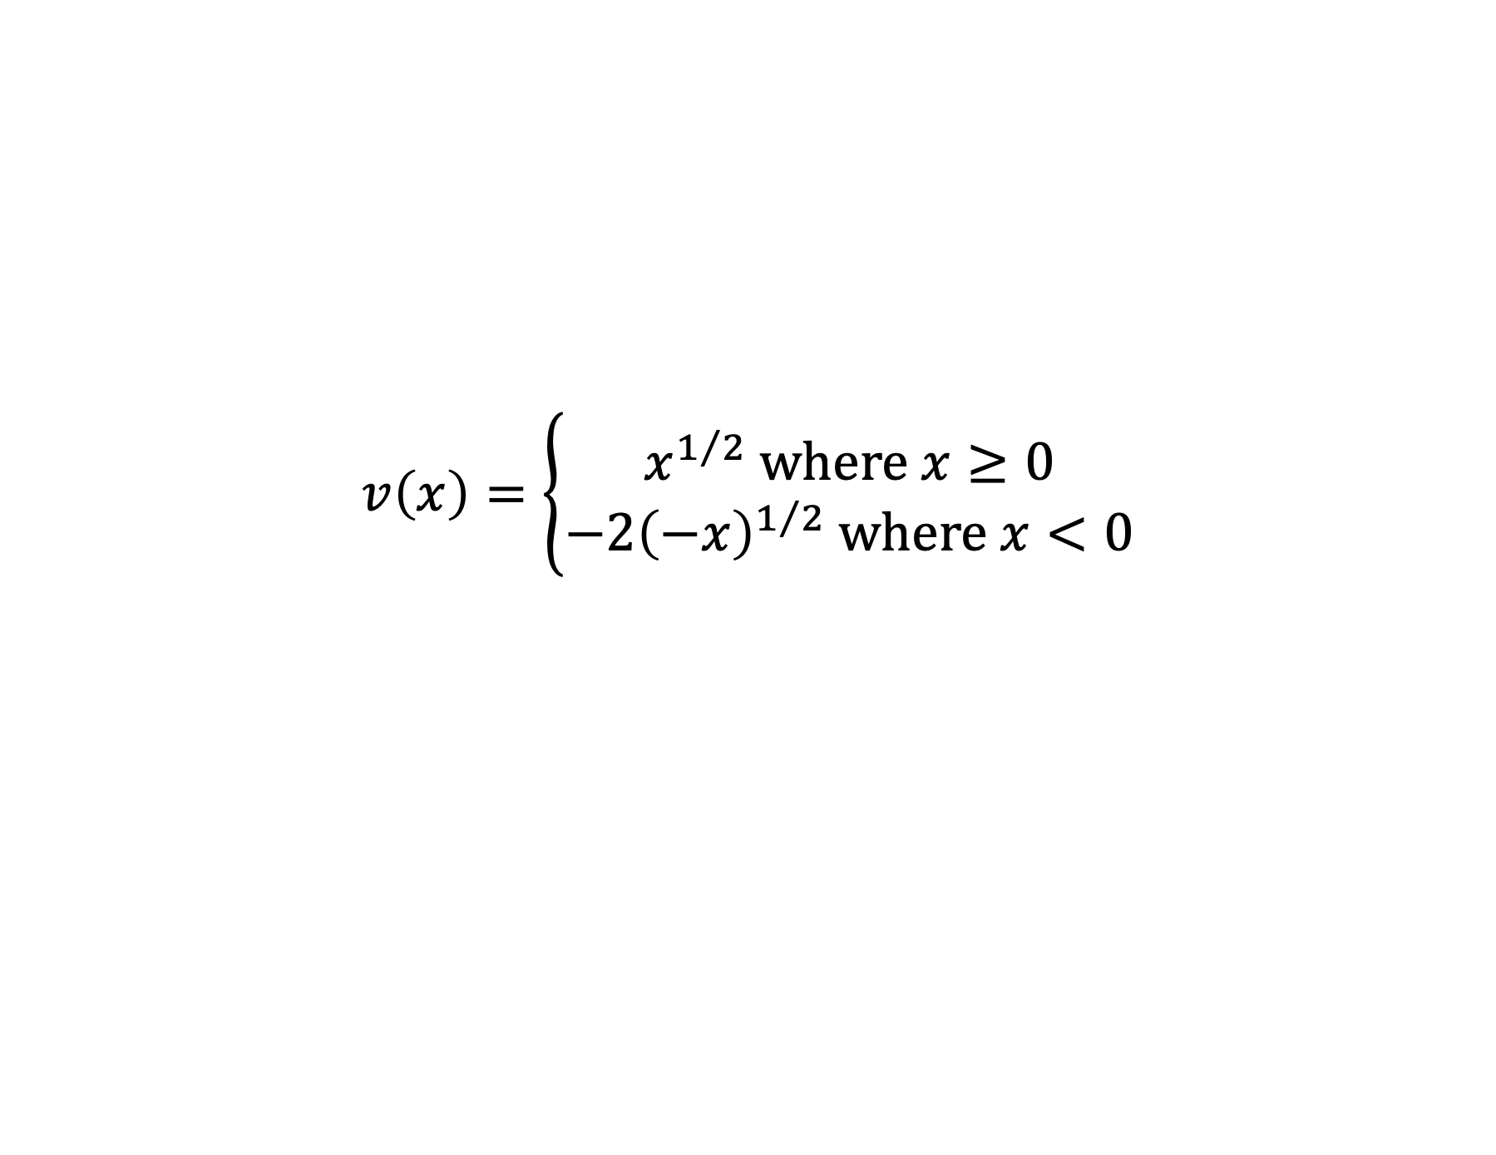
A 50:50 gamble
$$v\left(x\right)=\left\{\begin{aligned}x^{1/2} where x≥0 \\ −2{\left(−x\right)}^{1/2} where x<0\end{aligned}\right.$$

Slide 3
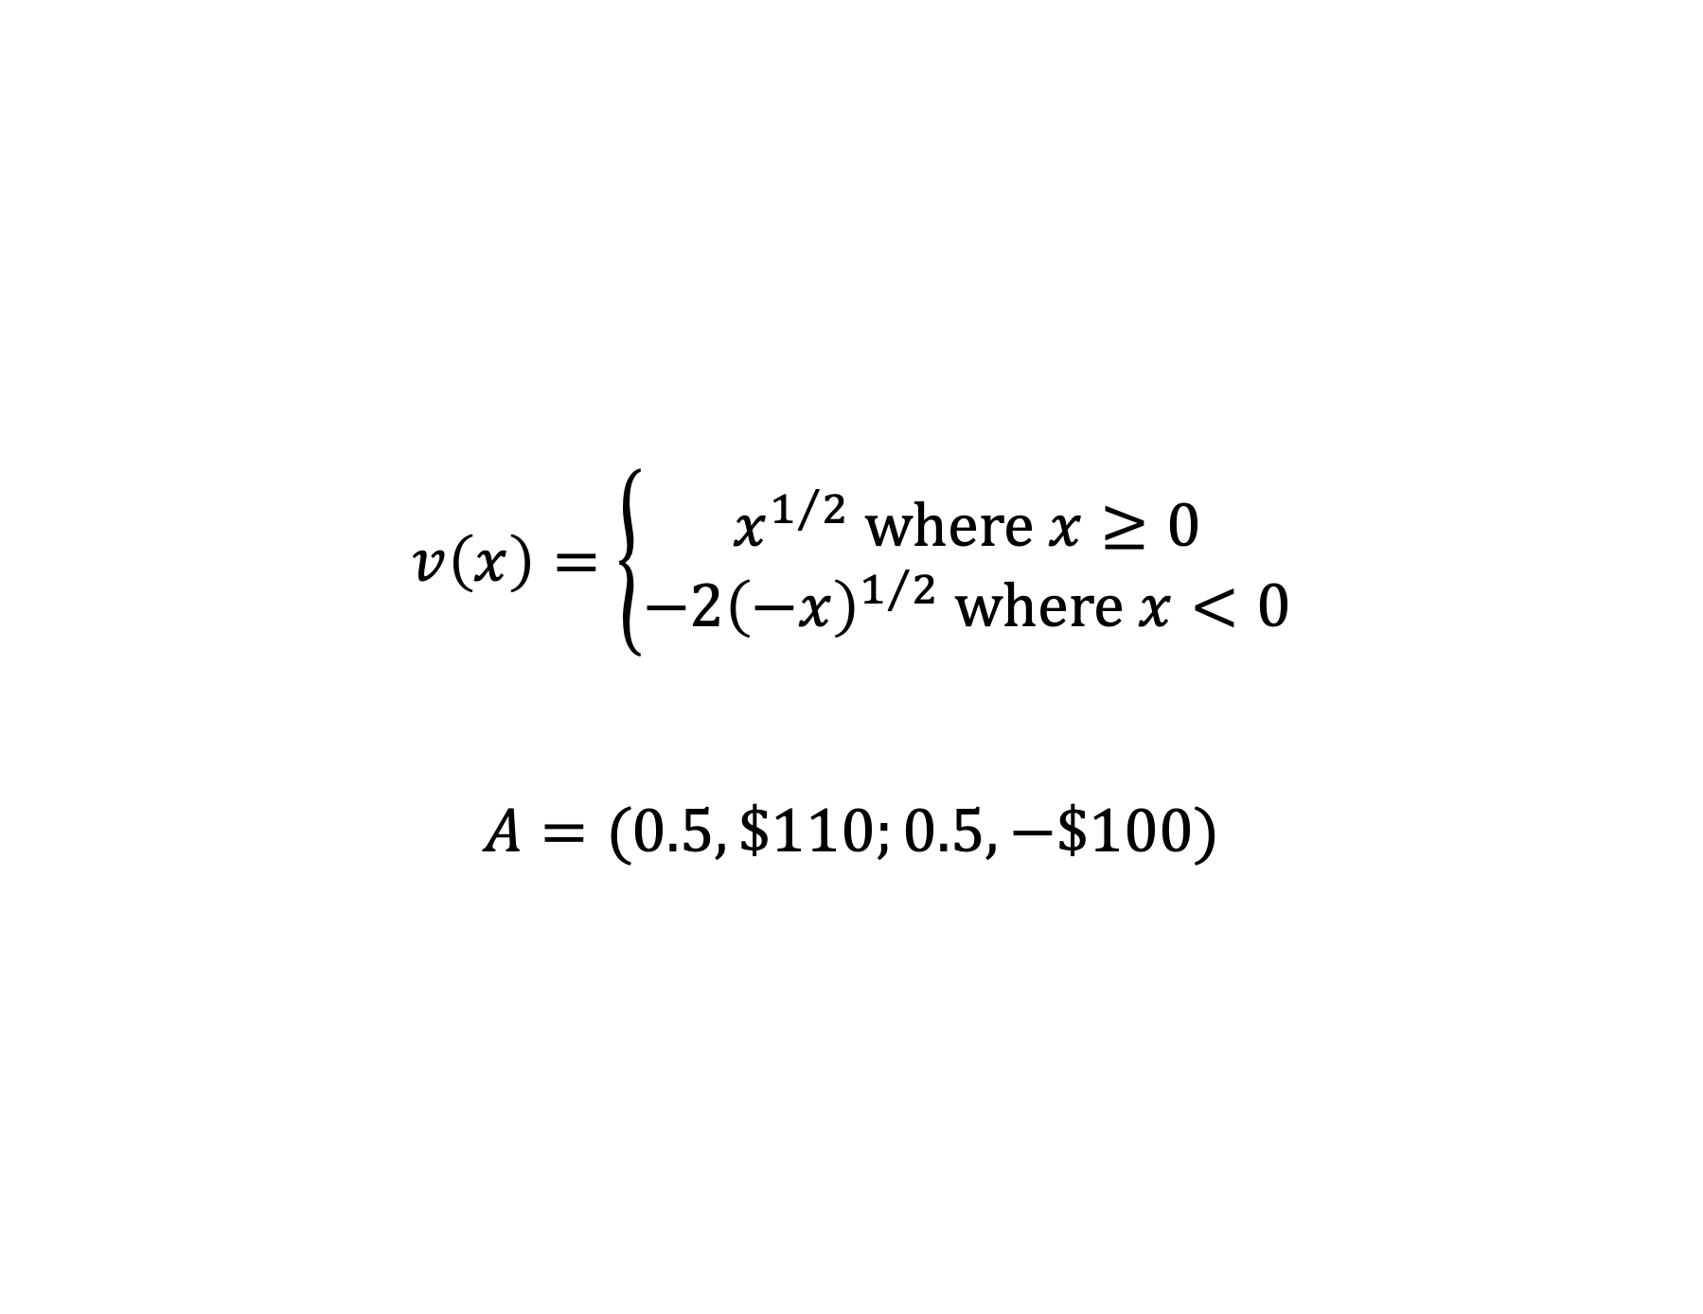
A 50:50 gamble
$$v\left(x\right)=\left\{\begin{aligned}x^{1/2} where x≥0 \\ −2{\left(−x\right)}^{1/2} where x<0\end{aligned}\right.$$
$$A=(0.5, \$110;0.5, −\$100)$$

Slide 4
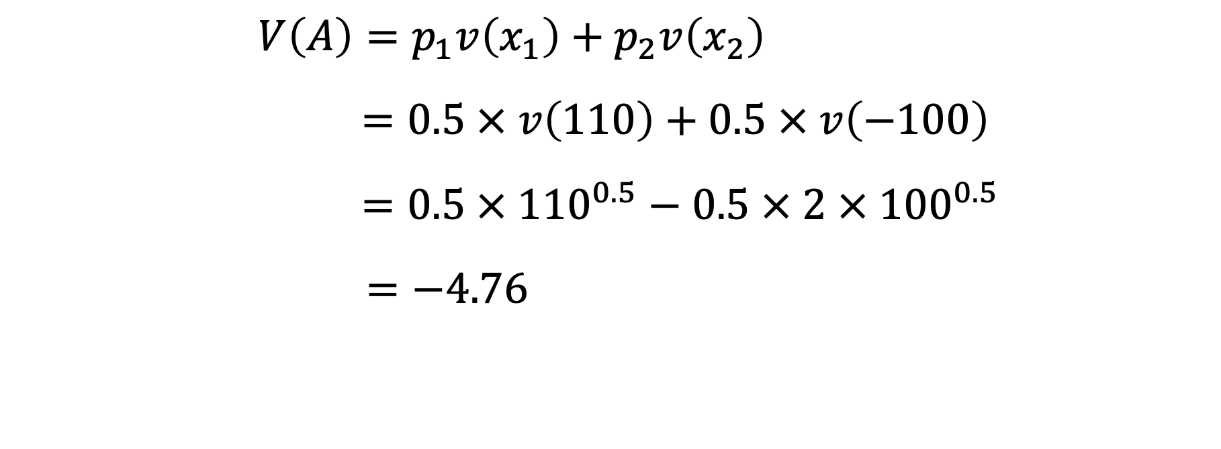
A 50:50 gamble: accept or reject?
$$V\left(A\right)=p_{1}v\left(x_{1}\right)+p_{2}v\left(x_{2}\right)$$
$$=0.5 × v\left(110\right)+0.5 × v\left(−100\right)$$
$$=0.5 × {110}^{0.5}−0.5 × 2 ×{ 100}^{0.5}$$
$$=−4.76$$

Slide 5
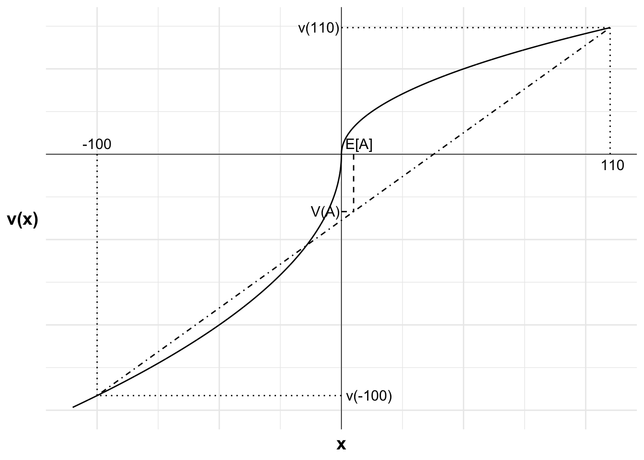
A 50:50 gamble: accept or reject?

Slide 6
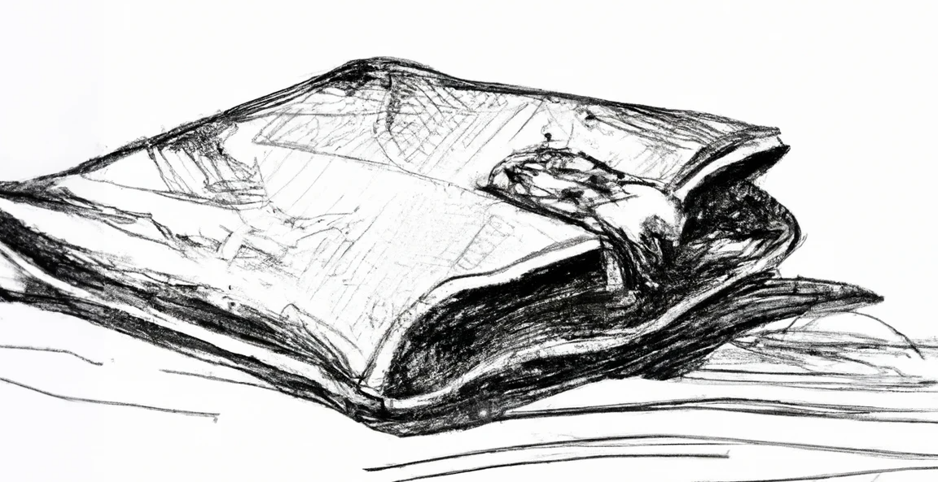
A 50:50 gamble: accept or reject after a loss?

Slide 7
A 50:50 gamble: accept or reject after a loss?
Lose gamble (-100)
Win gamble (+110)
Lost wallet
Reference point

Slide 8
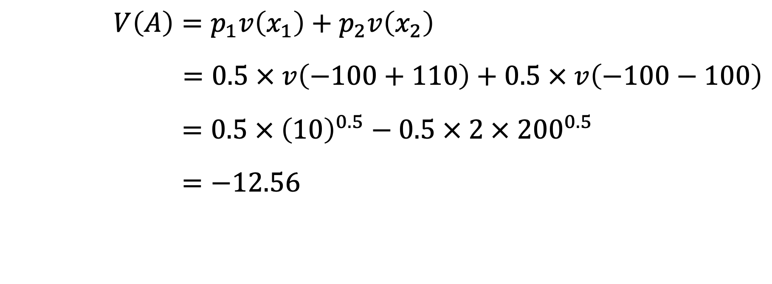
A 50:50 gamble: accept or reject after a loss?
$$V\left(A\right)=p_{1}v\left(x_{1}\right)+p_{2}v\left(x_{2}\right)$$
$=0.5 × v\left(−100+110\right)+0.5 × v\left(−100−100\right)$
$$=0.5 × {\left(10\right)}^{0.5}−0.5 × 2 × {200}^{0.5}$$
$$=−12.56$$

Slide 9
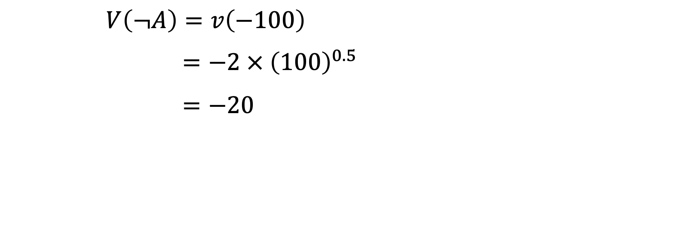
A 50:50 gamble: accept or reject after a loss?
$$V\left(¬A\right)=v\left(−100\right)$$
$$=−2 ×{ \left(100\right)}^{0.5}$$
$$=−20$$

Slide 10
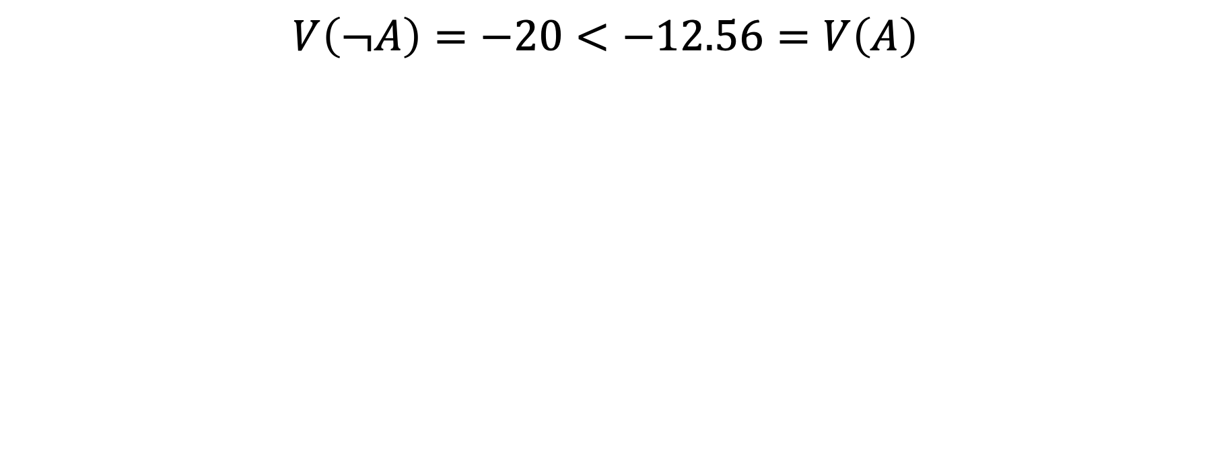
A 50:50 gamble: accept or reject after a loss?
$$V\left(¬A\right)=−20<−12.56=V\left(A\right)$$

Slide 11
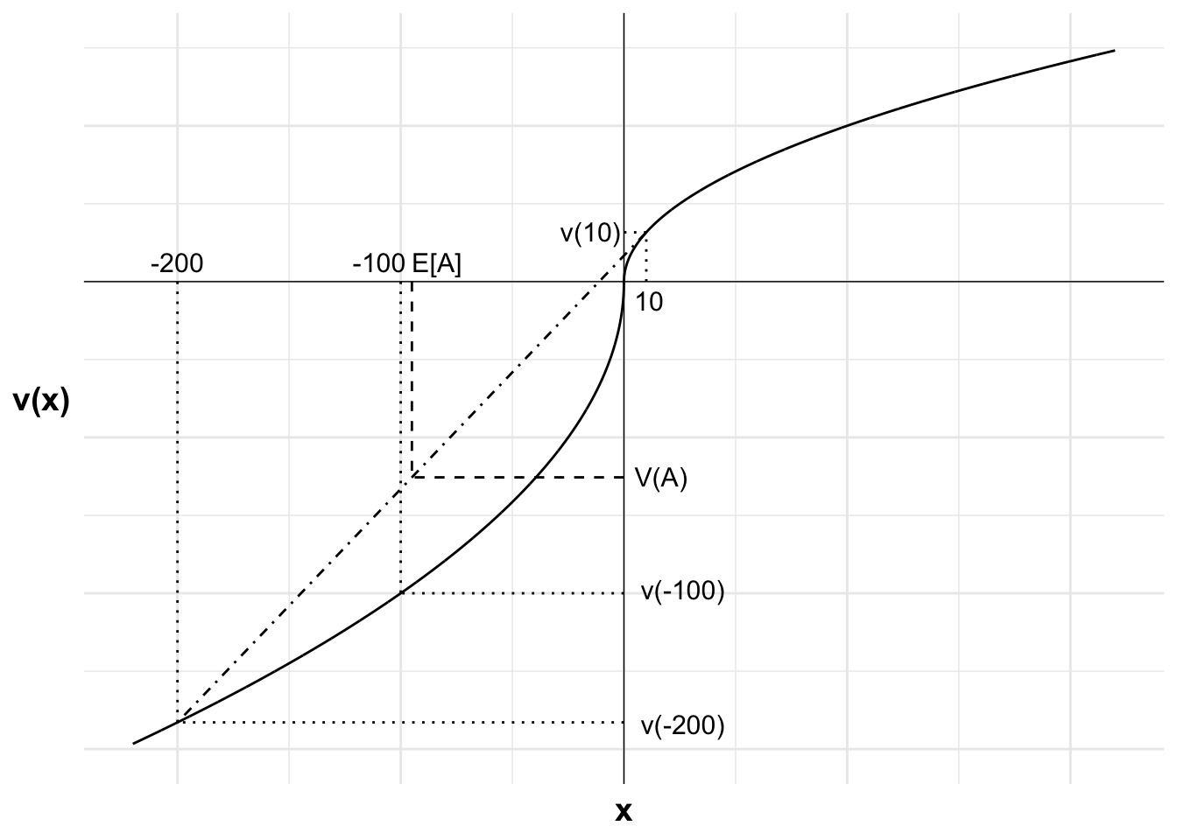
A 50:50 gamble: accept or reject after a loss?

Slide 12

A 50:50 gamble: accept or reject after adaptation to loss?

Slide 13
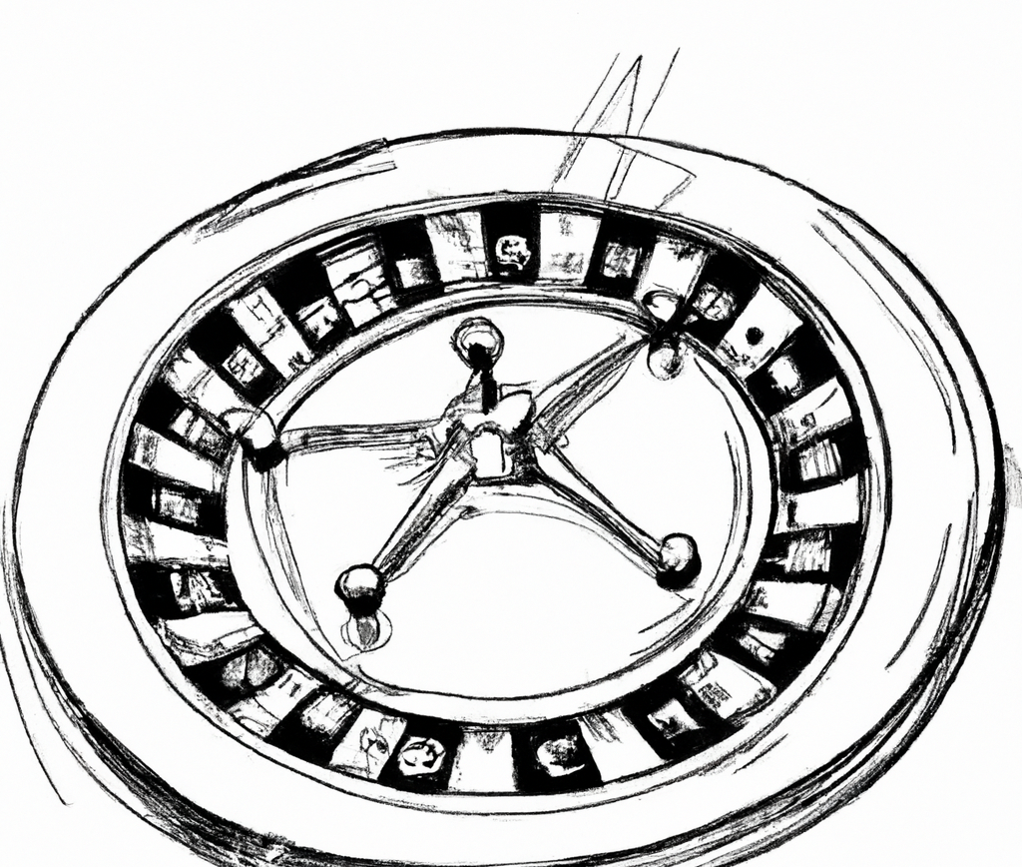
A 50:50 gamble: accept or reject after a win?

Slide 14
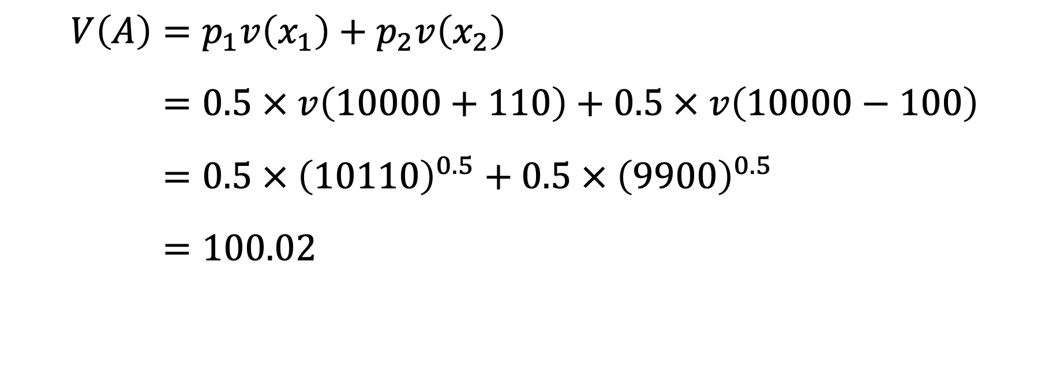
A 50:50 gamble: accept or reject after a win?
$$V\left(A\right)=p_{1}v\left(x_{1}\right)+p_{2}v\left(x_{2}\right)$$
$$=0.5 × v\left(10000+110\right)+0.5 × v\left(10000−100\right)$$
$$=0.5 × {\left(10110\right)}^{0.5}+0.5 × {\left(9900\right)}^{0.5}$$
$$=100.02$$

Slide 15
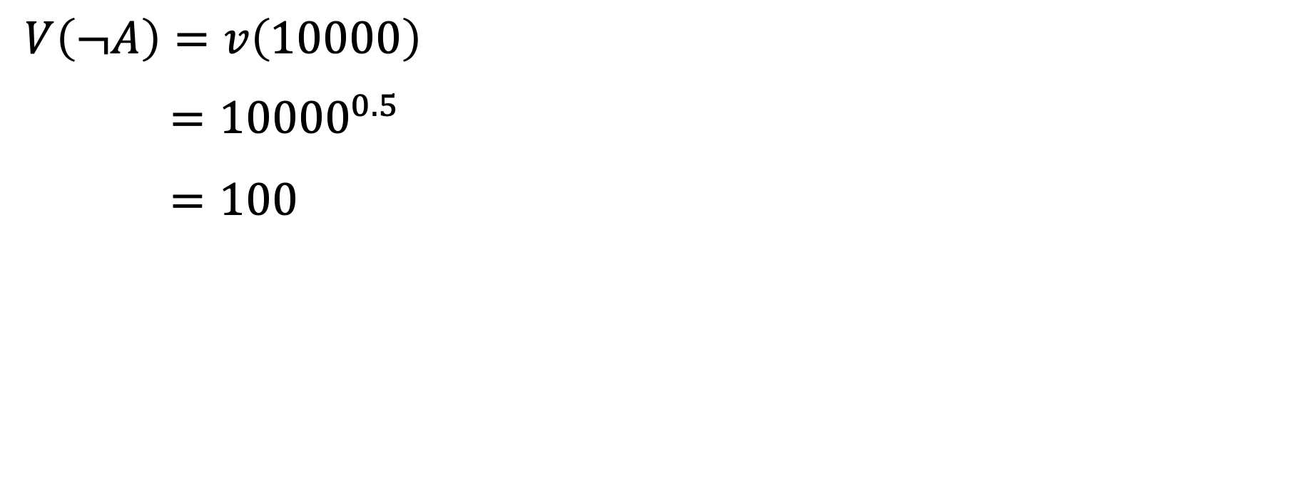
A 50:50 gamble: accept or reject after a win?
$$V\left(¬A\right)=v\left(10000\right)$$
$$={10000}^{0.5}$$
$$=100$$

Slide 16
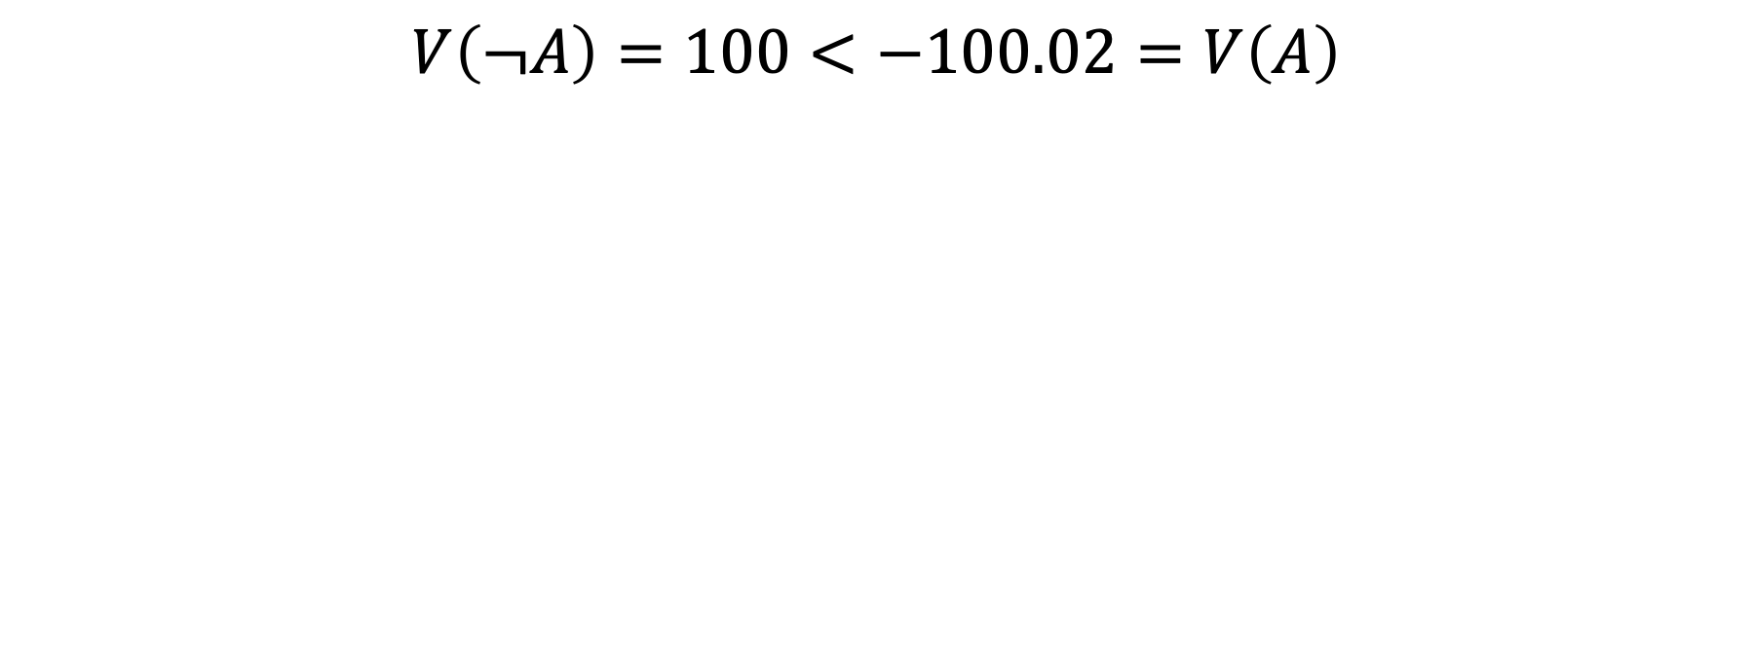
A 50:50 gamble: accept or reject after a win?
$$V\left(¬A\right)=100<−100.02=V\left(A\right)$$

Slide 17
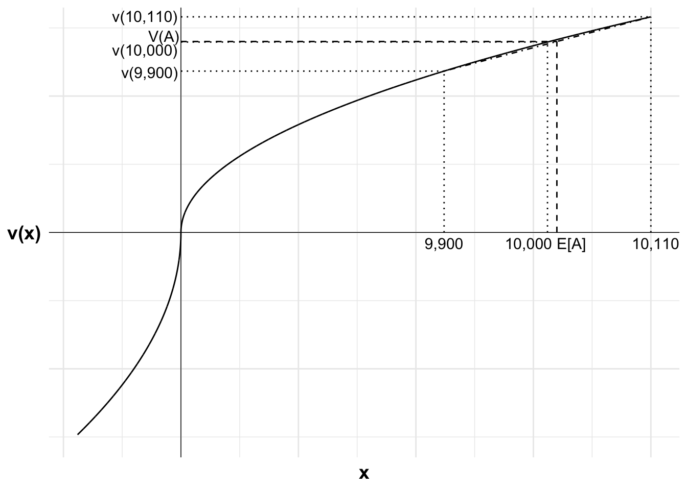
A 50:50 gamble: accept or reject after a win?

Slide 18
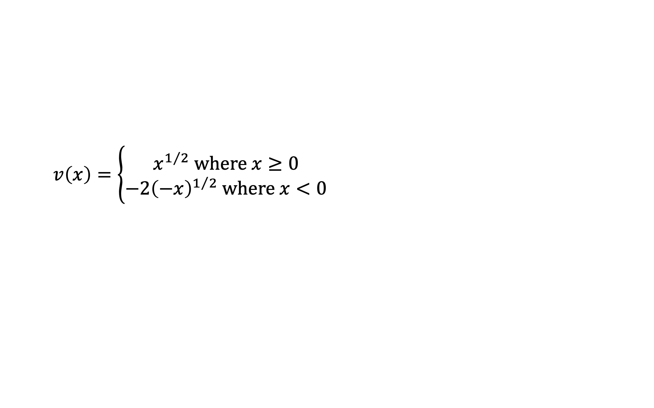
A 60:40 gamble
$$v\left(x\right)=\left\{\begin{aligned}x^{1/2} where x≥0 \\ −2{\left(−x\right)}^{1/2} where x<0\end{aligned}\right.$$

Slide 19
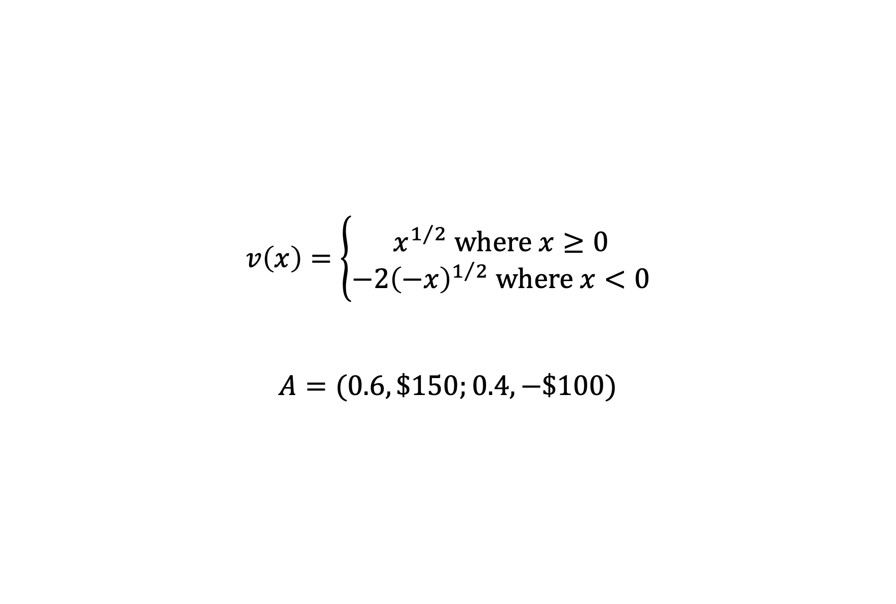
A 60:40 gamble
$$v\left(x\right)=\left\{\begin{aligned}x^{1/2} where x≥0 \\ −2{\left(−x\right)}^{1/2} where x<0\end{aligned}\right.$$
$$A=(0.6, \$150;0.4, −\$100)$$

Slide 20
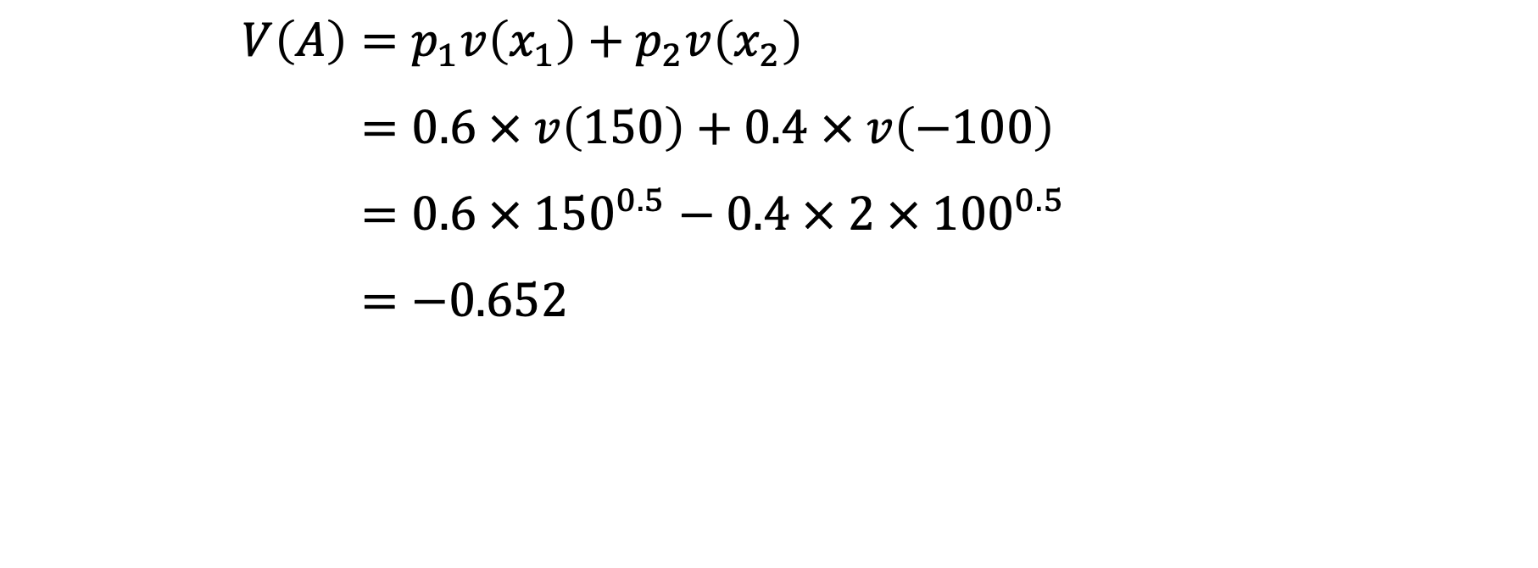
A 60:40 gamble: accept or reject?
$$V\left(A\right)=p_{1}v\left(x_{1}\right)+p_{2}v\left(x_{2}\right)$$
$$=0.6 × v\left(150\right)+0.4 × v\left(−100\right)$$
$$=0.6 × {150}^{0.5}−0.4 × 2 × {100}^{0.5}$$
$$=−0.652$$

Slide 21
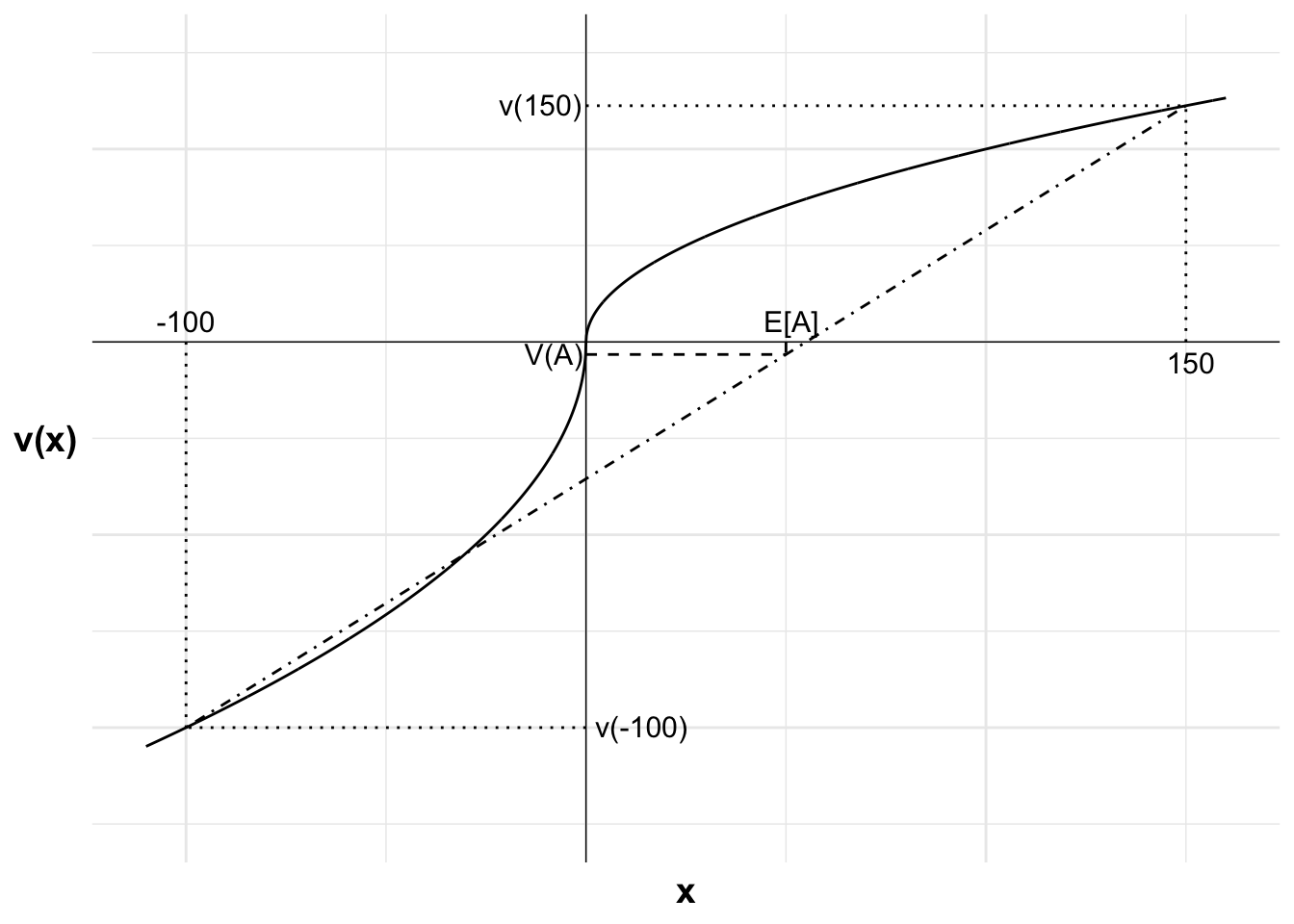
A 60:40 gamble: accept or reject?

Slide 22
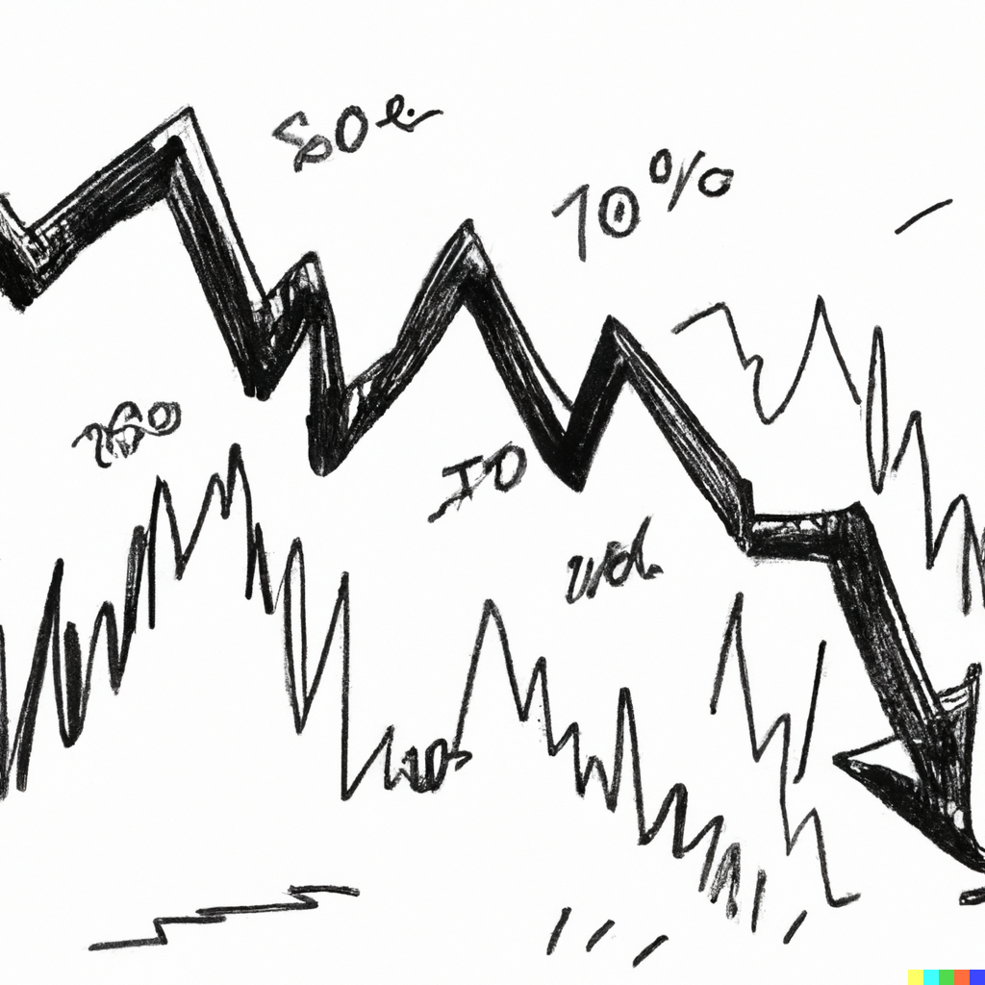
A 60:40 gamble: accept or reject after a loss?

Slide 23
A 60:40 gamble: accept or reject after a loss?
Lose gamble (-100)
Win gamble (+150)
New wealth
Reference point

Slide 24
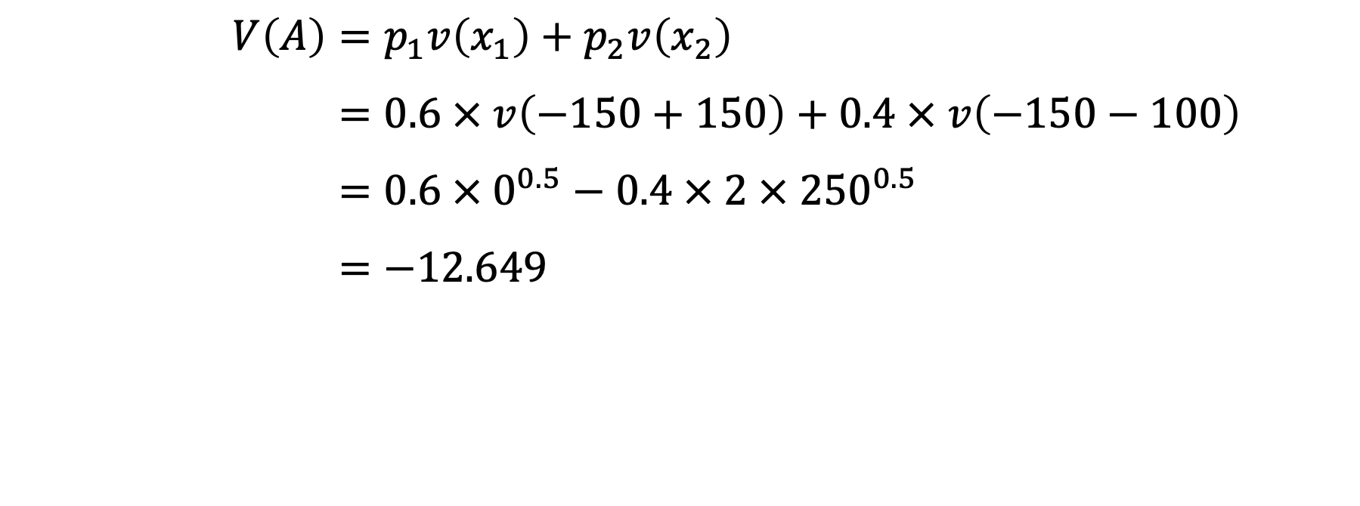
A 60:40 gamble: accept or reject after a loss?
$$V\left(A\right)=p_{1}v\left(x_{1}\right)+p_{2}v\left(x_{2}\right)$$
$$=0.6 × v\left(−150+150\right)+0.4 × v\left(−150−100\right)$$
$$=0.6 × 0^{0.5}−0.4 × 2 × {250}^{0.5}$$
$$=−12.649$$

Slide 25
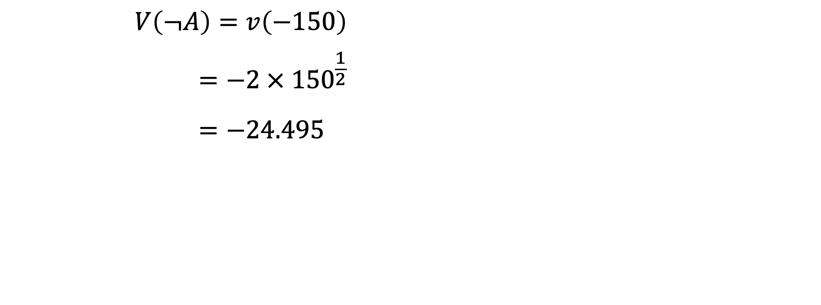
A 60:40 gamble: accept or reject after a loss?
$$V\left(¬A\right)=v\left(−150\right)$$
$$=−2 × {150}^{\frac{1}{2}}$$
$$=−24.495$$

Slide 26
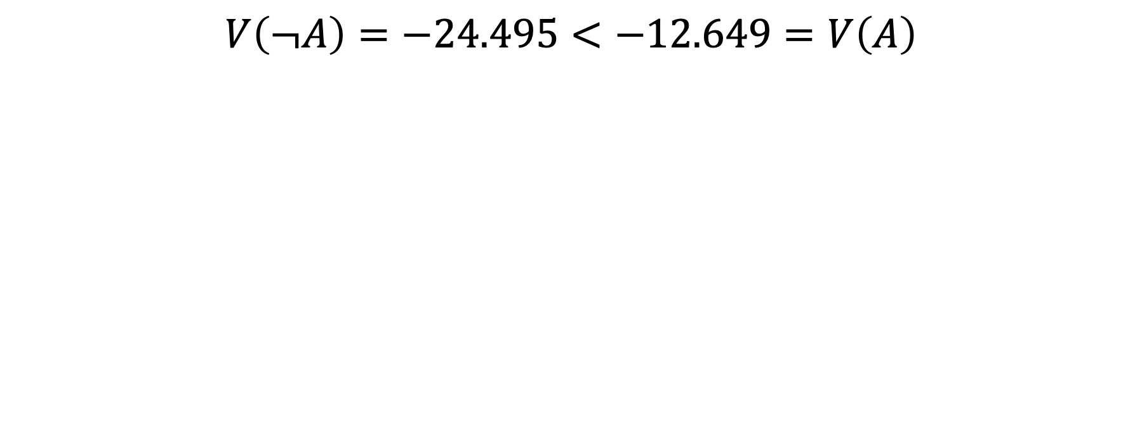
A 60:40 gamble: accept or reject after a win?
$$V\left(¬A\right)=−24.495<−12.649=V\left(A\right)$$

Slide 27
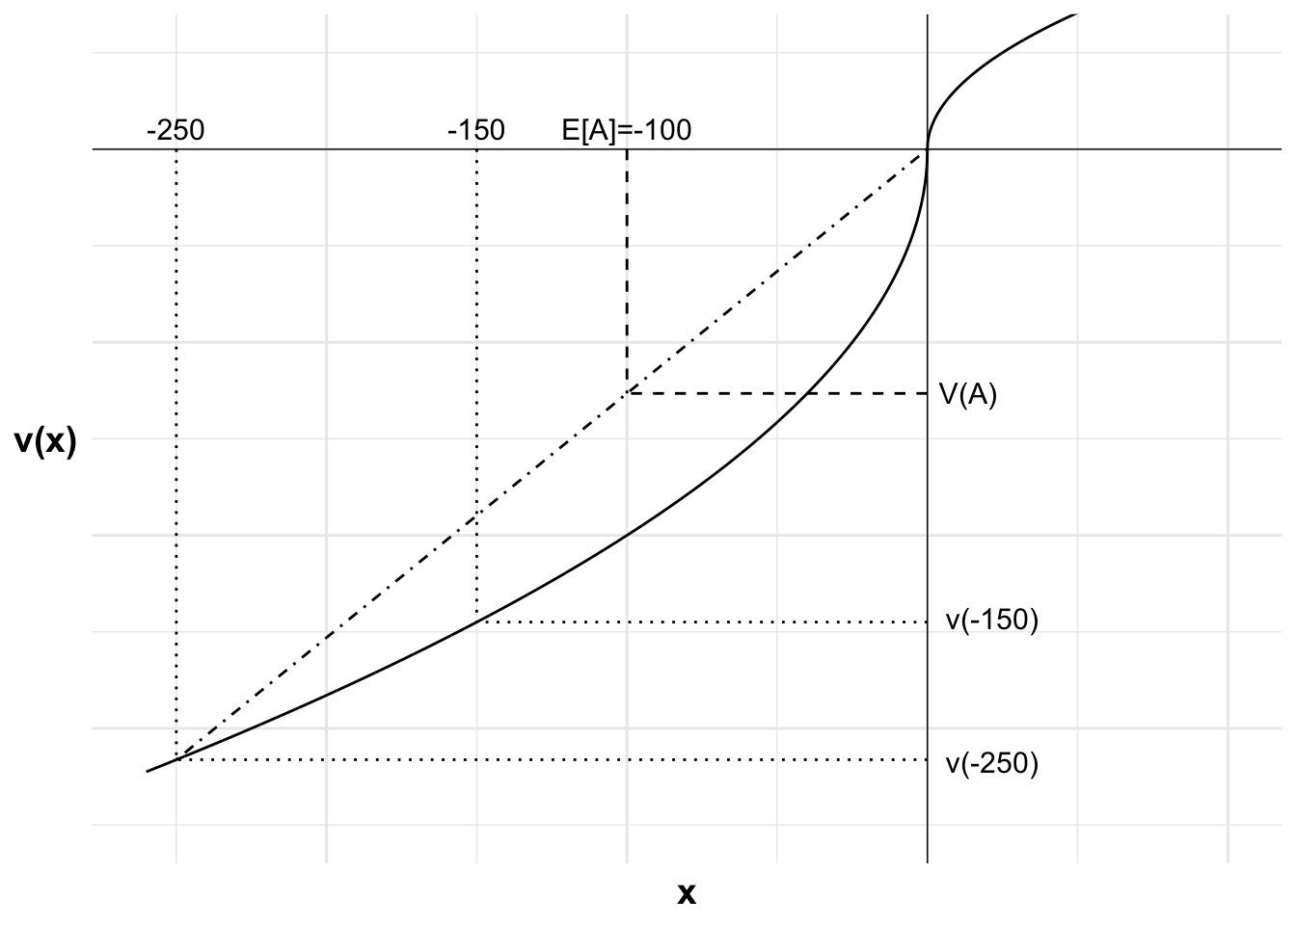
A 60:40 gamble: accept or reject after a loss?

Slide 28
A gamble in the gain domain
$$v\left(x\right)=\left\{\begin{aligned}x^{1/2} where x≥0 \\ −2{\left(−x\right)}^{1/2} where x<0\end{aligned}\right.$$

Slide 29
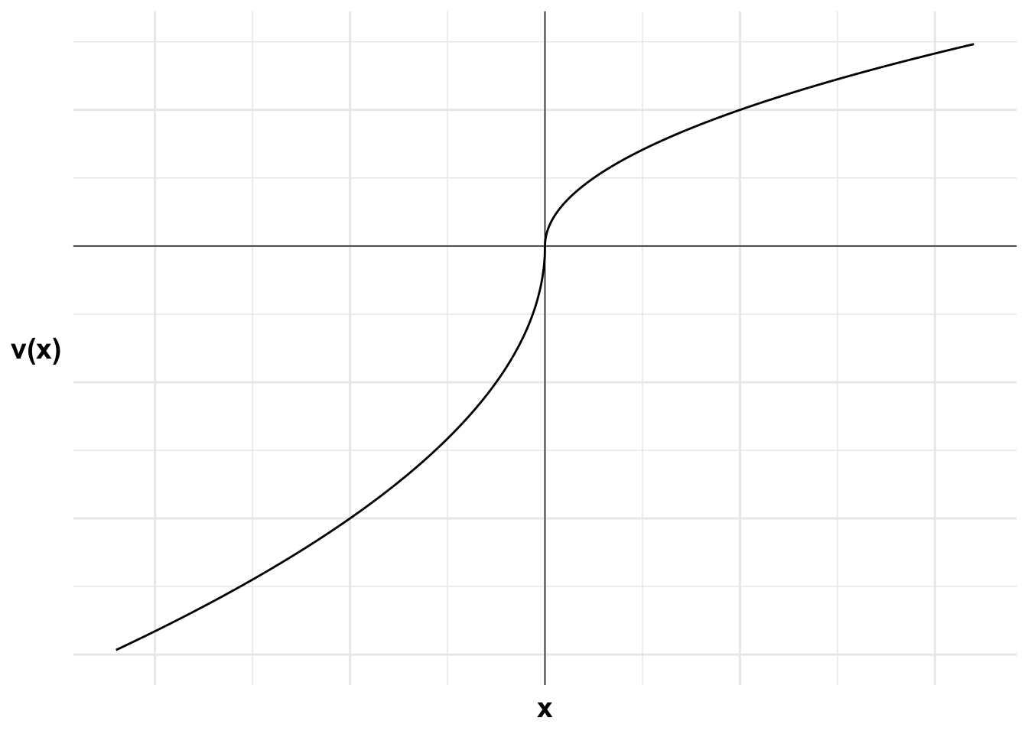
A gamble in the gain domain

Slide 30
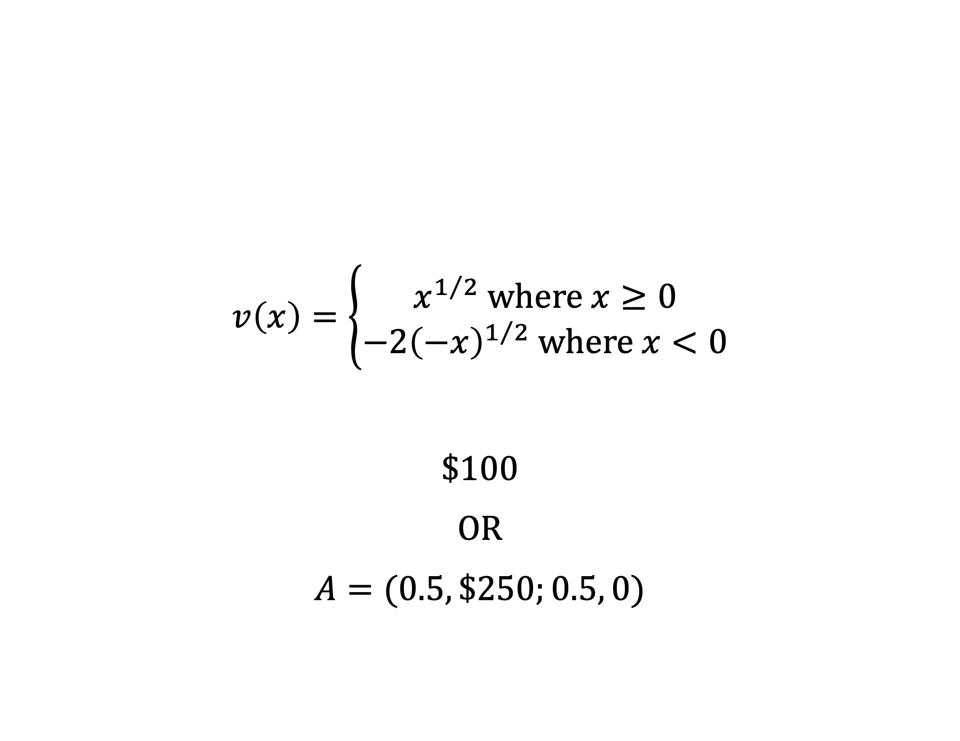
A gamble in the gain domain
$$v\left(x\right)=\left\{\begin{aligned}x^{1/2} where x≥0 \\ −2{\left(−x\right)}^{1/2} where x<0\end{aligned}\right.$$
$100
OR
$$A=(0.5, \$250;0.5, 0)$$

Slide 31
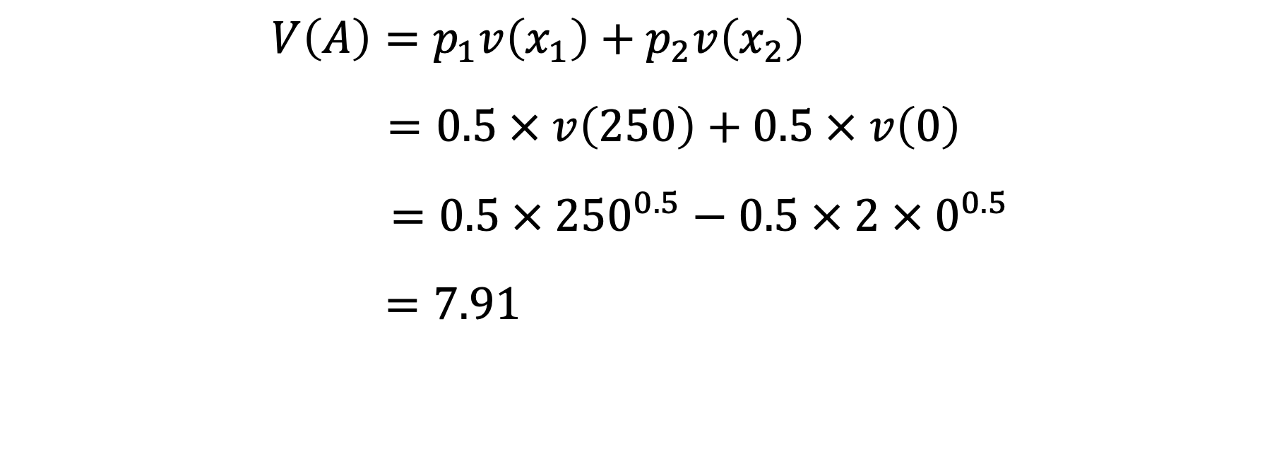
A gamble in the gain domain: accept or reject?
$$V\left(A\right)=p_{1}v\left(x_{1}\right)+p_{2}v\left(x_{2}\right)$$
$$=0.5 × v\left(250\right)+0.5 × v\left(0\right)$$
$$=0.5 × {250}^{0.5}−0.5 × 2 ×{ 0}^{0.5}$$
$$=7.91$$

Slide 32
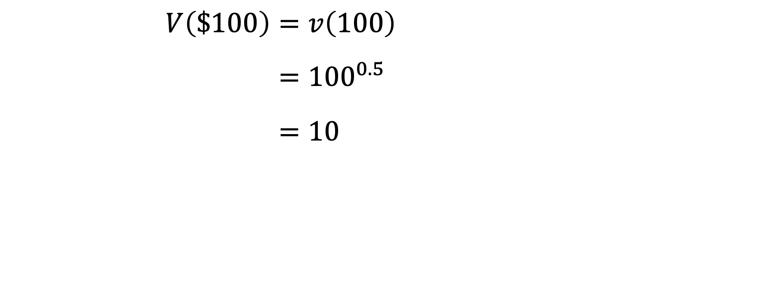
A gamble in the gain domain: accept or reject?
$$V\left(\$100\right)=v\left(100\right)$$
$$={100}^{0.5}$$
$$=10$$

Slide 33
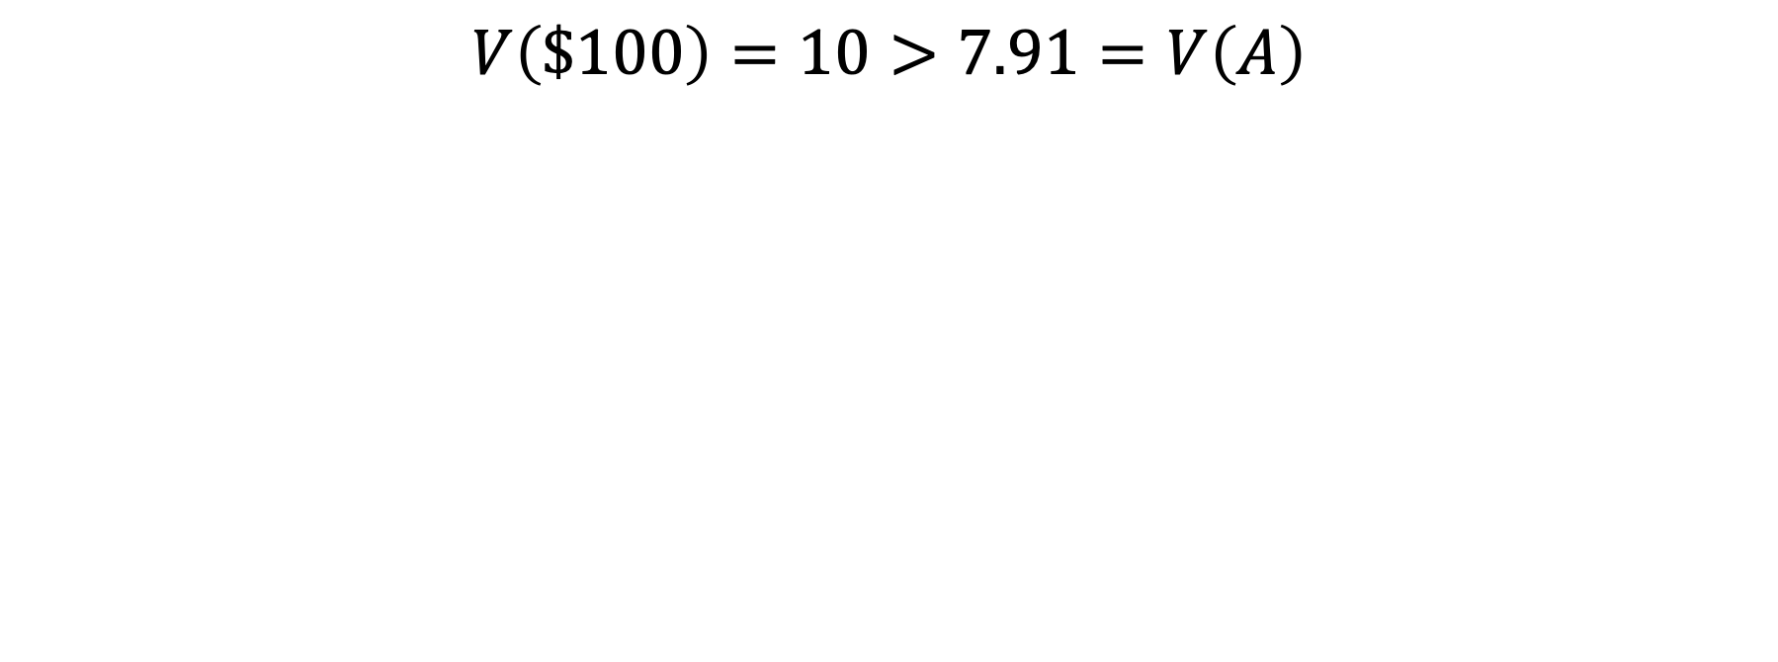
A gamble in the gain domain: accept or reject?
$$V\left(\$100\right)=10>7.91=V\left(A\right)$$

Slide 34
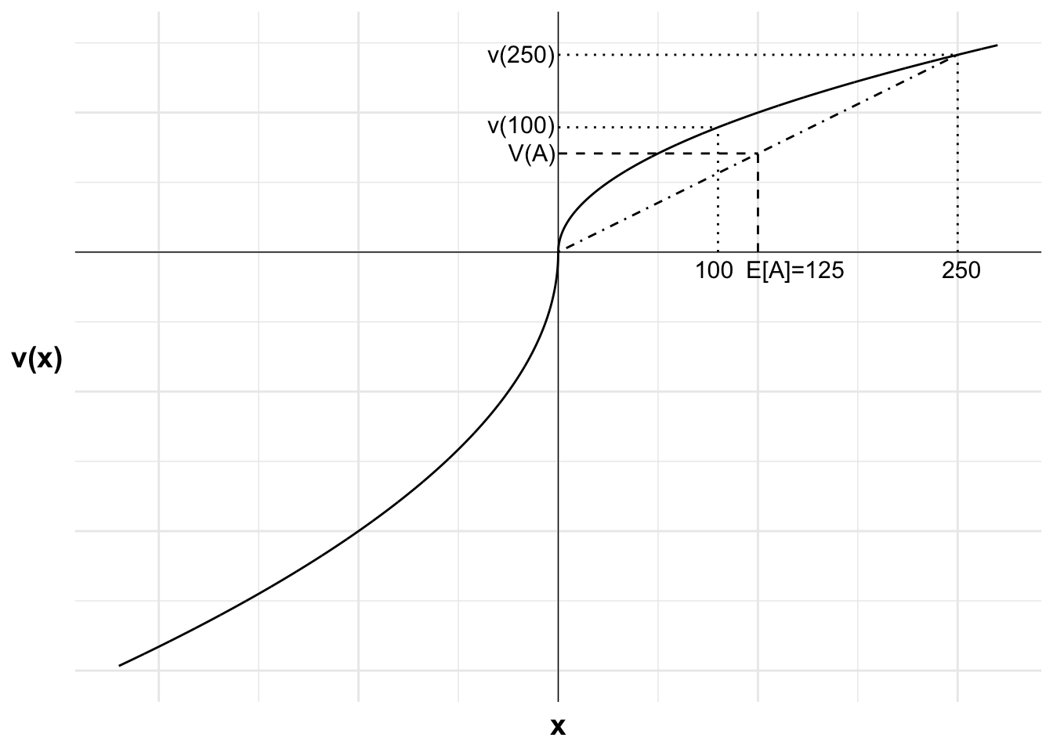
A gamble in the gain domain: accept or reject?

Slide 35
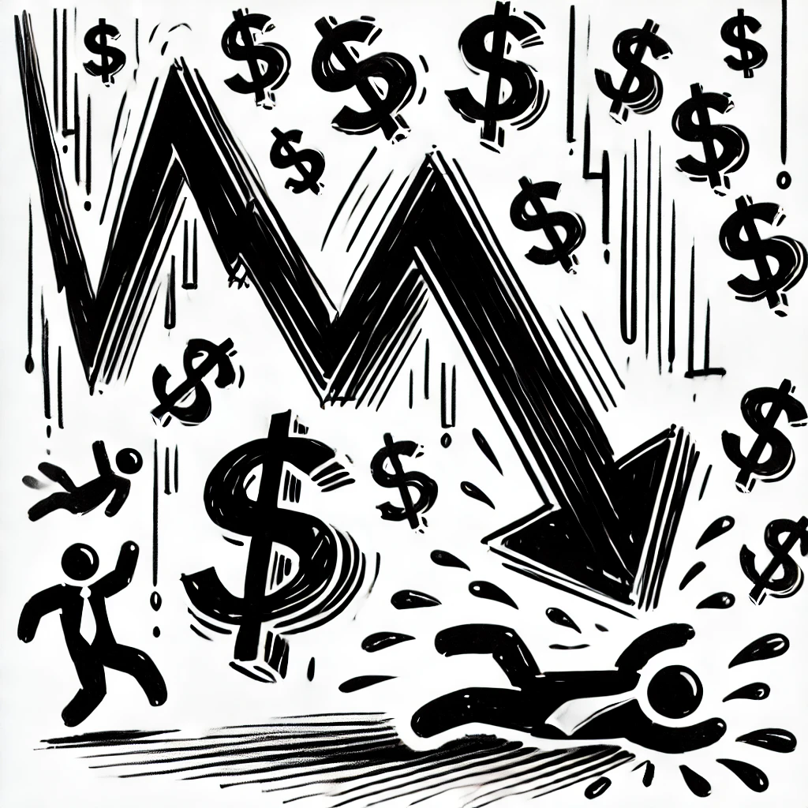
A gamble in the gain domain: accept or reject after a negative shock?

Slide 36
A gamble in the gain domain: accept or reject after a negative shock?
Win gamble (+250)
0
L+250
L
Certain gain (+100)
Reference point

Slide 37
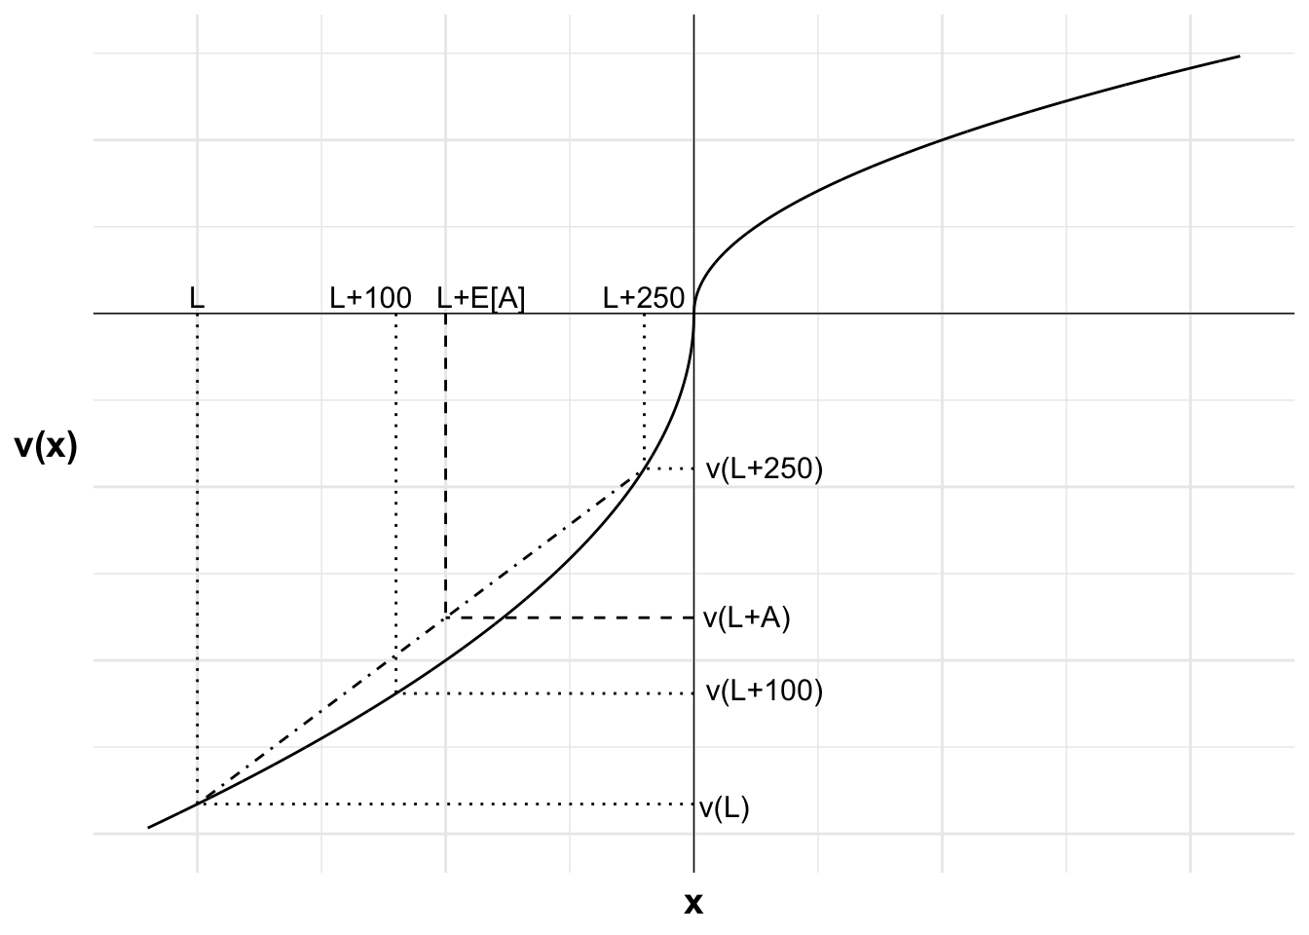
A gamble in the gain domain: accept or reject after a negative shock?

